Slide 1


Lending Club Case study
Course 2 Module 4
May 2022
Pooja Surve-Mahadik & Nikhil Nan

Slide 2

Agenda
Project Overview
Analysis Approach
Analysis and Findings
Results Dsicussion
Recommendations and Conclusions

Slide 3


Project Overview
Objective
Lending Club is an online market place company facilitating personal loans, business loans, and financing of medical procedures. Objective of the project is to analyse the organization’s historic loan data and identify patterns and key drivers that will enable the organization to take actions such as denying the loan, reducing the amount of loan, lending (to risky applicants) at a higher interest rate, etc. to a new applicant.
Analysis Approach
The project will progress as follows:
Understanding of the dataset
Data Cleansing and Preparation
Univariate Analysis
Bivariate Analysis
Discussion of Observations
Recommendations

Slide 4
Data Familiarization and Data Preparation
Data Description
The data set contains 5 years loan data of the company for the period 2007 to 2011. It contained over 110 attributes of the data such as the loan amount details, applicant details, sanction status, repayment status etc.
Null value & Unique value fields
After the initial screening, it has been found that the over 50 attributes were empty attributes with null values. These 54 columns were dropped from the data set.
Further there were around 10 columns which had some portion of null values. These attributes were prepared by techniques such as mean/median/mode value replacement.
Additionally, the columns that contained unique values (same values in all the cells of the column) were dropped as it is not adding any value to the analysis.
Data type conversion
By analyzing the data, appropriate data conversions were done such as converting interest rate column from text to float.
Derived Columns
Columns were derived based on the existing columns such as bucketizing loan amount & income, deriving date, month and year from date columns etc. to add more dimensions to data for deriving insights.
Summary
After data cleaning and preparation, the dataset was ready with about 50 attributes to start with for the analysis

Slide 5
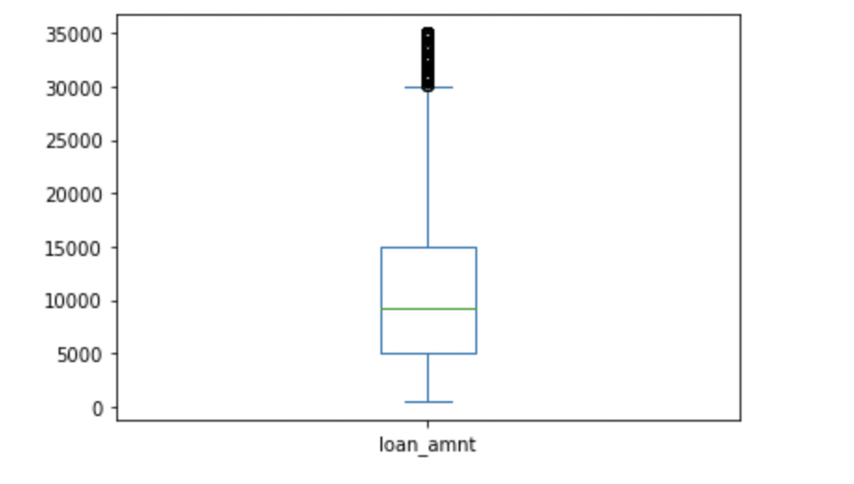
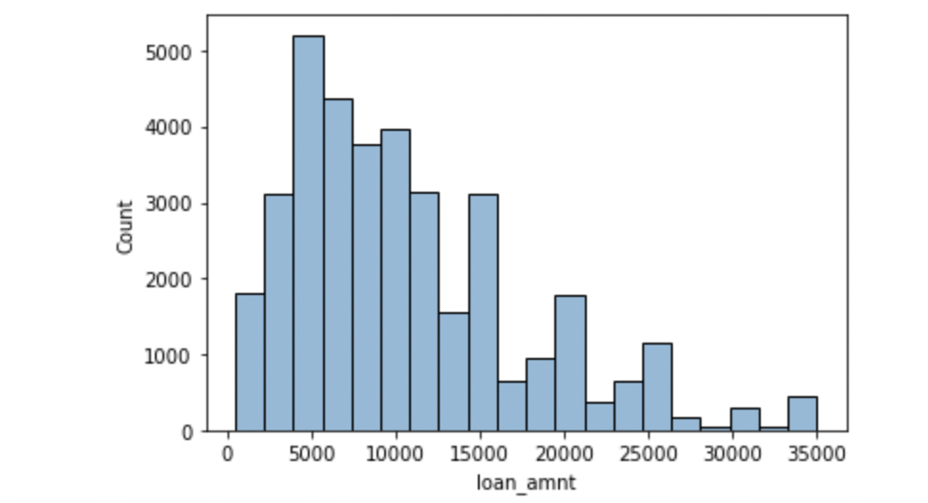
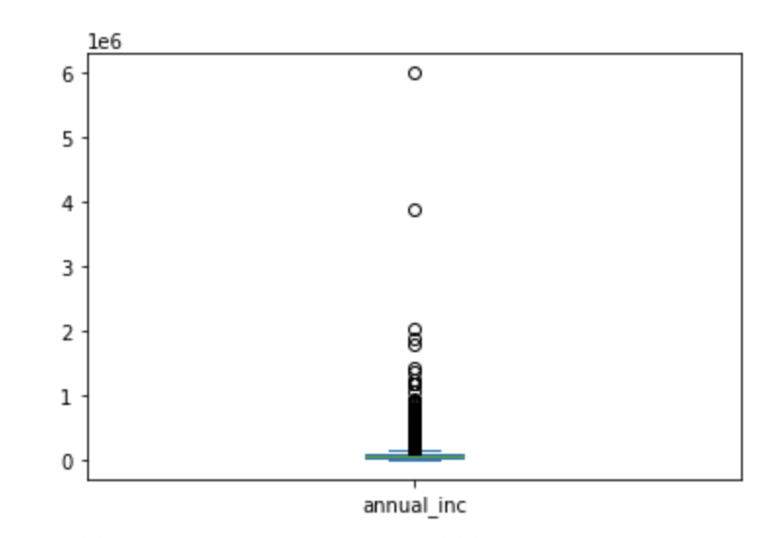
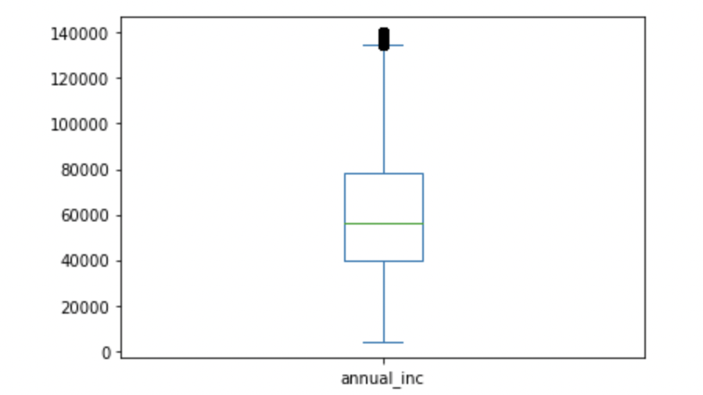
Univariate Analysis Discussion
Loan Amount Distribution
Loan amount distribution box plot and histogram
Univariate analysis helped to look at the distribution of the loan amounts and the key observations were:
Average loan amount was ~$10k, while the median was around ~$9.2k.
75% of the loan amounts were under $15k.
Maximum loan amount sanctioned was $35k
Annual Income Distribution
Annual Income Distribution plot before and after outlier removal
Univariate analysis helped to look at the distribution of the annual income of the applicants and the key observations were:
The annual amount had outliers revealed by the box plot.
Outliers were removed by removing values >95 percentile.
Annual income varied from $4k to $117k
Mean was ~$57k and median ~$55k
75% of the applicant’s income were under $74k

Slide 6
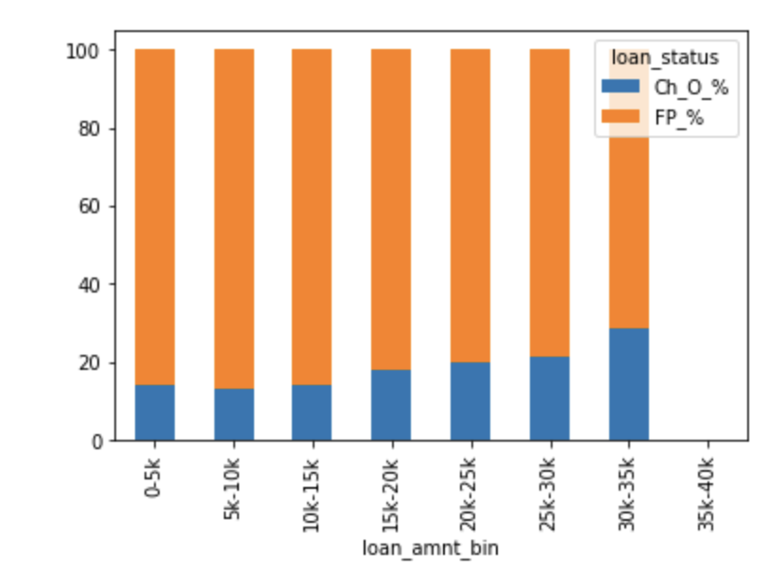
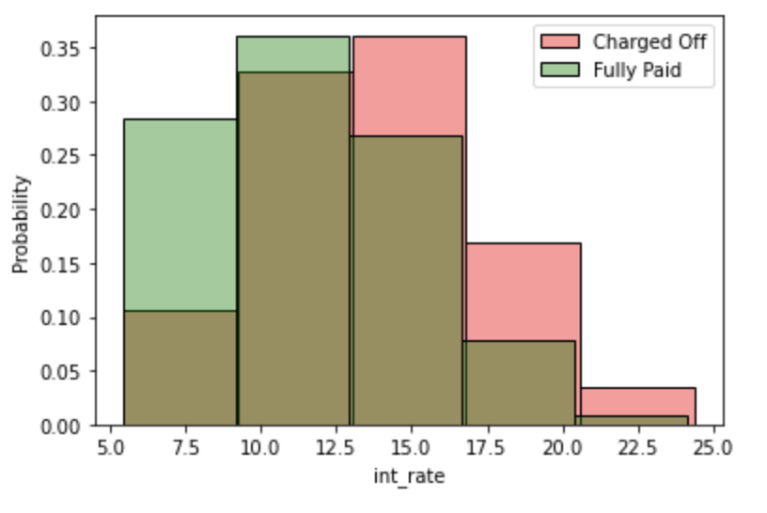
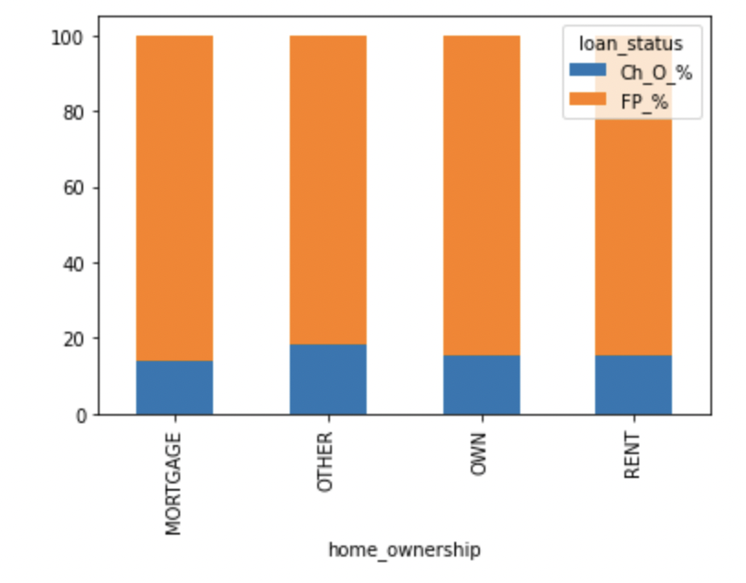
Bivariate Analysis Discussion
Laon Amount vs. Delinquency
Interest Rate vs. Delinquency
Interest Rate vs. Delinquency
There’s an increasing trend in delinquency: delinquencies are higher in higher loan amounts; highest 20% in $30k-$35k category and lowest – 13% in $5k-10k category
High delinquencies are observed in higher interest rate groups.
Relatively similar delinquency rates across home ownership categories
Highest observed in OTHER category with 18%

Slide 7
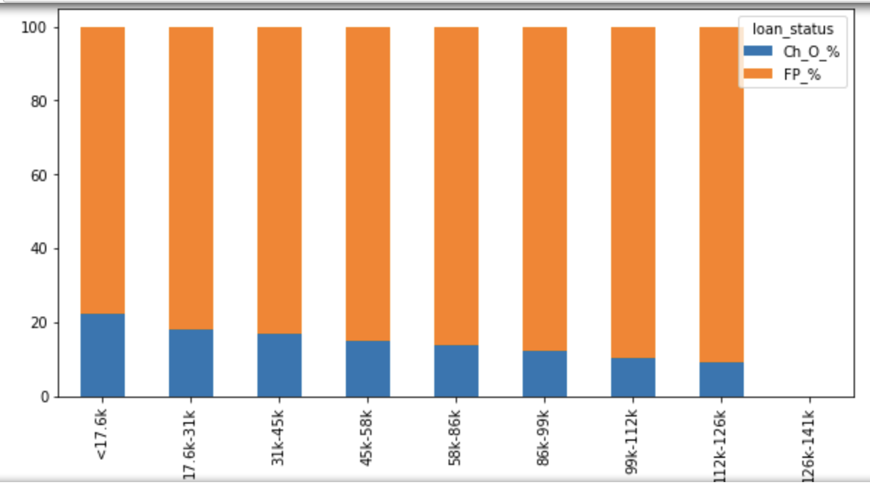
Bivariate Analysis Discussion
Annual Income vs. Delinquency
Highest delinquency in the lower income group
Highest delinquency at 22% in <$17k annual income

Slide 8
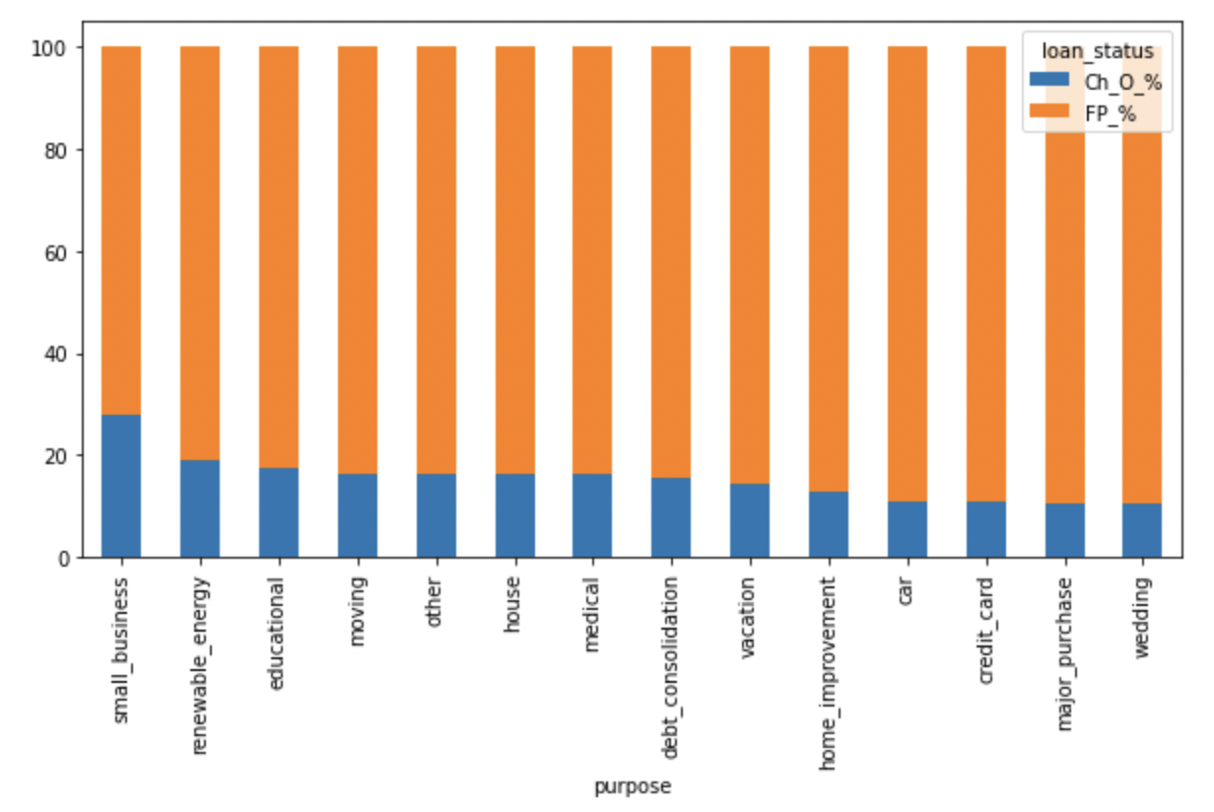
Bivariate Analysis Discussion
Laon Purpose vs. Delinquency
Purpose SMALL BUSINESS has the highest delinquency with 28%
Wedding has the lowest at 10.3%

Slide 9
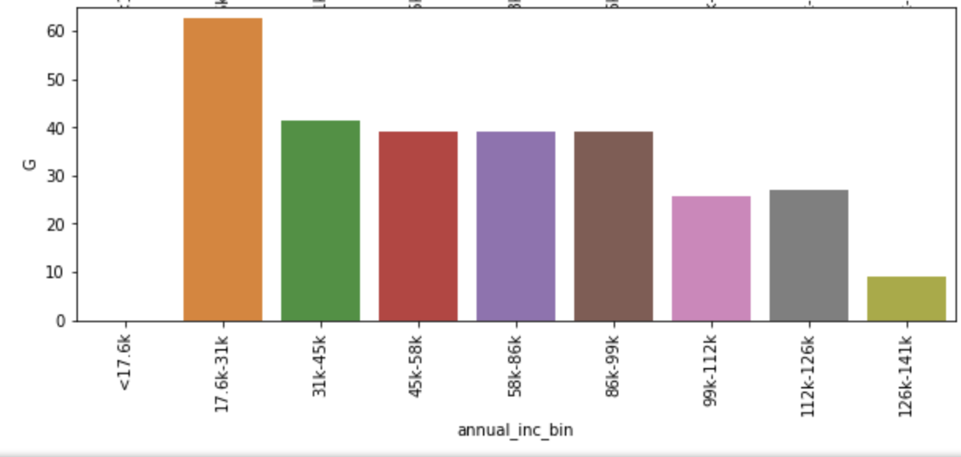
Bivariate Analysis Discussion
Annual Income & Grade vs. Delinquency
Highest delinquency of 63% observed in Grade G with lowest annual income($17k - $31k

Slide 10
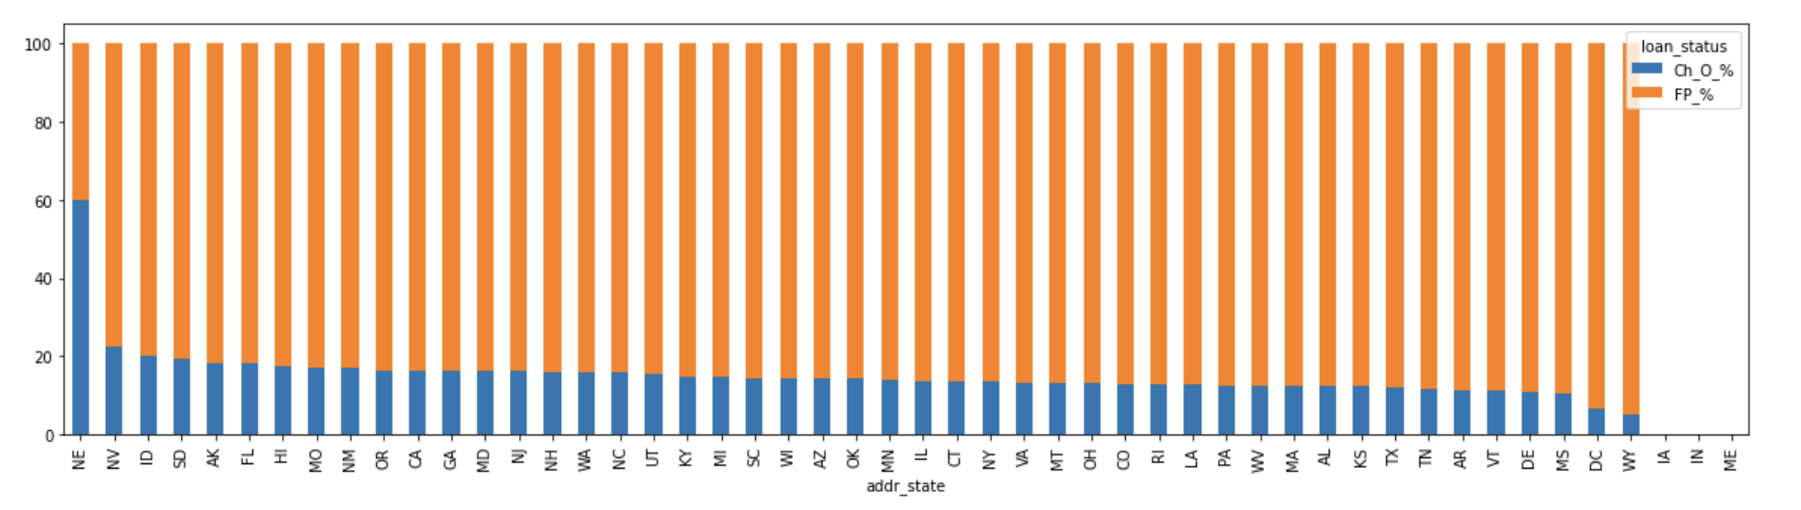
Bivariate Analysis Discussion
State vs. Delinquency
Highest delinquency of 60% observed in Nevada
Lowest in Wyoming at 5%

Slide 11
Discussion of Observations & Recommendations
Key Influencers
Key influencer attributes are:
Purpose
Annual Income
State
Grade
Recommendation
A risk model to be developed based on these attributes with a base interest rate.
Based on the risk model, add on interest rates are added to the base interest rate to compensate for delinquency risk.

Slide 12
Understanding of the dataset
1

Slide 13
Observations
Understanding the data set
There are multiple columns with only null values
Some columns have only 1 unique value and null
Columns like int_rate, revol_bal and emp_length which are numeric are counted as string because of additional text
Few columns have more than 70% null values
The data set has loan types as Fully Paid, Charged Off and Current. Current type of loans won’t be needed for the analysis.

Slide 14
Data Cleansing and Preparation
2

Slide 15
Data Cleaning
Deleting columns with only null or single values
Observation | Dropped columns
There are few columns with only null or single values. These columns have been given first priority for deletion. | tot_hi_cred_lim total_bal_ex_mort total_bc_limit total_il_high_credit_limit
Columns with too many null values | next_pymnt_d mths_since_last_record mths_since_last_delinq
Columns with only zero or null values | collections_12_mths_ex_med chargeoff_within_12_mths tax_liens
Not useful | last_pymnt_d last_credit_pull_d
Columns with only 1 unique value | pymnt_plan initial_list_status policy_code application_type acc_now_delinq delinq_amnt
Since current types of load won’t be useful for analysis, the same shall be removed.
There are some outliers in annual_inc. Therefore, values above 95 percentile shall be removed.

Slide 16
Data Cleaning
Missing values
emp_length
The column has texts which needs to be removed to create buckets.
The null values shall be replaced by median of the data set. It is also observed that the mean of the column is almost 4.
revol_util
The column has % sign after every value. This sign needs to be removed to perform analysis.
Null values in the column shall be replaced by the median of the data set.
int_rate
The column has % sign after every value. This sign needs to be removed to perform analysis.
pub_rec_bankruptcies
<1 years shall be replaced by 0 and 10+ years with 10. All other years shall be replaced by corresponding number.
Also it is observed that there is not much difference in mean and median.
Null values shall be replaced by 0 i.e. the median of the column
home_ownership
The column has only 3 NONE as values, which can be considered as null.
Since the mode of the column is RENT, replacing all NONE values with RENT

Slide 17
Deriving values
New features for analysis
issue_d Issue date of the loan
The column first needs to be converted to correct date format.
Post that month and year of the issue date can be derived.
annual_inc Annual income of the borrower
Annual income of the borrower can be used to compute the monthly income.
By subtracting installment amount from above value, approximate savings value can be derived

Slide 18
Univariate Analysis
3

